Slide 1
Quizard Quest
by Anthony Cloudy, Nathan Moore, Gustavo Castillo, Peter DeNicola, and Joe St. Angelo

Slide 2
What is Quizard-Quest
A new way for students to make and study with flashcards.
Utilizes the reward structure of video games to create motivation for studying.
Uses a “spoonful of sugar” approach to create excitement and enjoyment for studying.

Slide 3
Current Features
Create a New User Account
Known as becoming a Quizard
Login as a Current User
Or with Facebook
View Your Game Statistics
Includes Gold
And stats per subject category

Slide 4
Current Features
Create and View Flashcards
Known as spells in game
Create, View, and Edit Decks
Known as spellbooks in game
Enter Challenges
You answer your flashcards
And battle monsters
And win experience and gold

Slide 5
Current Features
3 Types of Challenges:
Training - slow-paced and easy
Quest - challenging
Save the World - timed and intense
Buy New Avatars with Gold
Logout When You Finish

Slide 6
2.0 Features
Allow users to friend each other and share decks.
Allow more items and features to be bought in the store:
New themes for the website
Additional avatars
Different heart icons

Slide 7
2.0 Features
Implement a rating system for cards and decks.
Allow Facebook Login through the android app.
Add achievements to be unlocked through gameplay.

Slide 8
2.0 Features
Allow users to create cards to immediately go into a new deck.
Link the rest of the game functionality and modes to the Android Application.

Slide 9
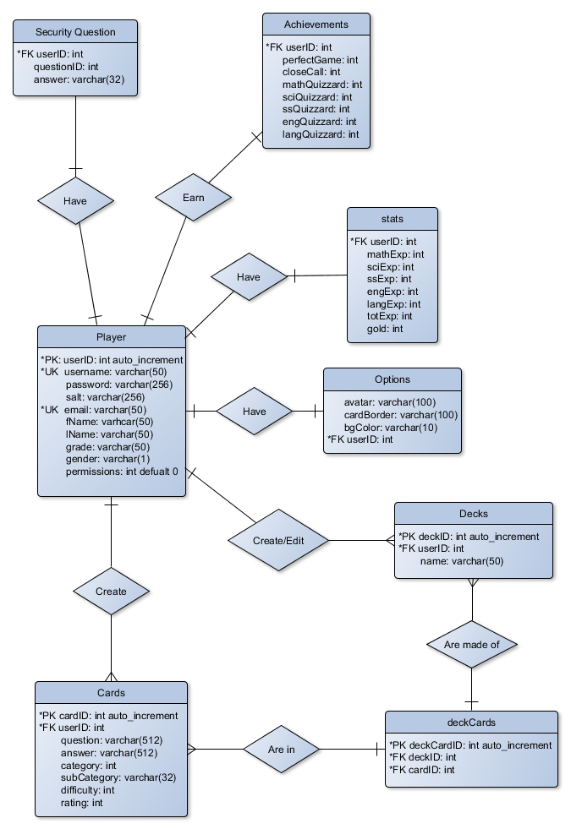
Physical DB Model
Physical DB Model

Slide 10
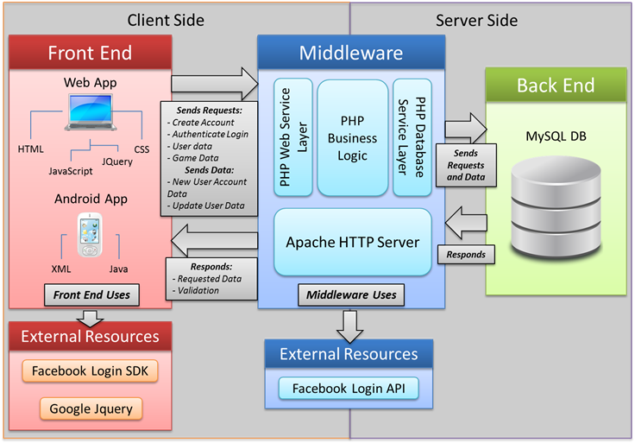
Software Architecture

Slide 11
Challenges: Web
Dynamically Loading Data
AJAX
XMLHTTP request
Creating our own API framework
Designing a Functional Game
That works and flows with the website
Is easy to learn
And fun to play.

Slide 12
Challenges: Android
Deciding what Features to Include
Complements website functionality
Building the API Support
Debugging Android Errors
Illegal use of activities
Failure to connect to the DB

Slide 13
Project Take Away
Don’t let Gus make any css changes
Especially Color Schemes
Nathan’s small edits are never small
Joe is a pretty good DJ
Peter loves DOTA
Anthony likes video games

Slide 14
